Slide 1

Katten Idle Game
CSC335 Team-project
Notes:
Notes to discuss:
1.

Slide 2
Agenda
Background Story
Player’s mission
Rules explanation
End goal
Notes:
Notes to discuss:
1.

Slide 3
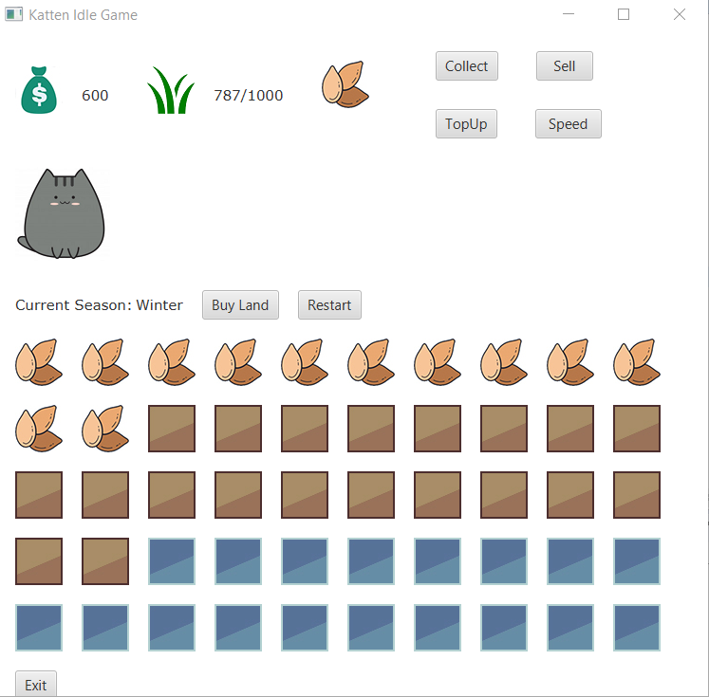
Background Story
A wandering cat just lost his parents due to a car accident and his parents left him a legacy – a few pieces of catnip. When player starts the game the left corner shows the amount of dollars and catnip. The middle position shows how many cats the player currently owns. The game still “runs” in the background when user exits.
Once the amount of cats reaches three, player’s mission is completed.

Slide 4
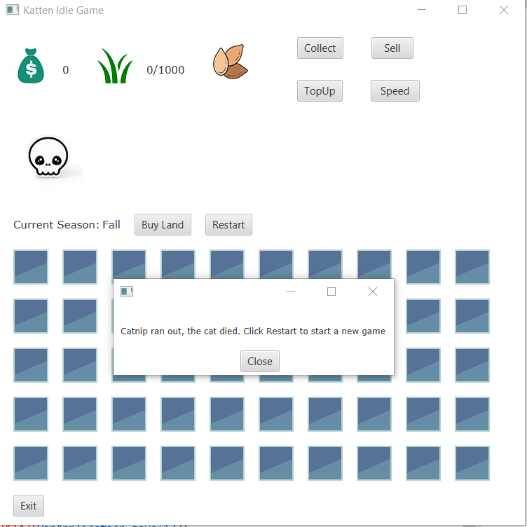
Player’s mission
The player must help the cat to survive and eventually help him to form a family. As the game begins, a few squares of the field is available to farm, and user must drag the seeds to the fields for the catnip to be available to harvest after a certain time. The player must diligently harvest the field because if you don’t the fields will be not available to continue to produce catnip and it will eventually result in the catnip to decrease to zero, causing the cat to die due to no food to eat (a cat eats 1 catnip per 6 min).

Slide 5
Rules Explanation
Opening a square of the field costs $100
Speed up feature costs $100, it boosts the seed growing process also will speed up the catnip consumption by 5x faster
TopUp provides a option that user can buy the game currency with money
One hour in real life represents one year in game. The year is divided into four seasons: spring, summer, fall, and winter. Each season lasts for 15 minutes.
A planted seed will become ripe after 5 minutes in spring, 3 minutes in summer, 1 minute in fall, and 10 minutes in winter.
A cat eats 1 catnip per 6 minutes
If there is no catnip for the cat to eat, the cat will die, and the player will fail the mission.
If the player brings the amount of catnip to above 800, then the cat will have a girlfriend and complete the game.

Slide 6
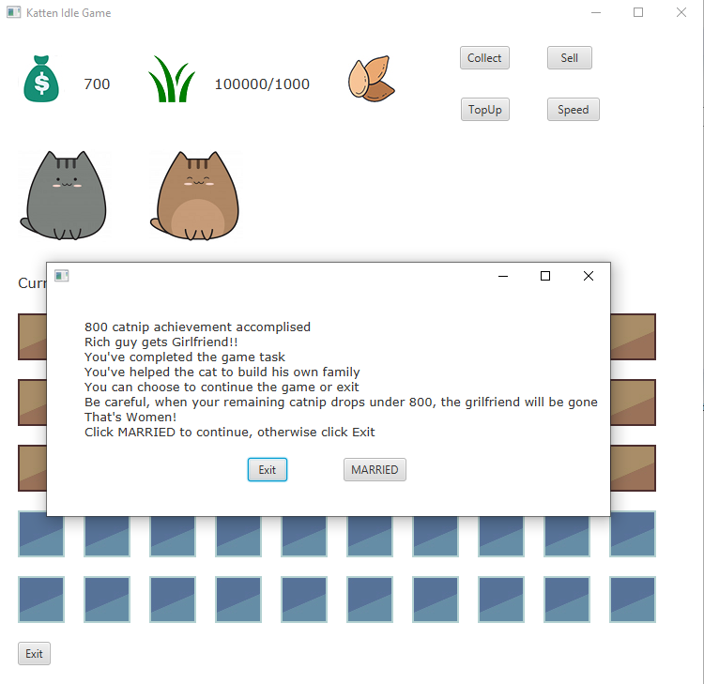
End Goal
The end goal is to help the cat create his own family.
This goal can be achieved by obtaining a girlfriend.
A girlfriend can be obtained by getting 800 catnip.
After completion of this task, the user may continue in free play mode or exit.

